Slide 1

Analyzing FIFA World Cup Trends and Patterns
2014
This presentation reviews trends and patterns related to the FIFA World Cup tournaments from 1930 to
Notes:
Today, I’ll be presenting an analysis of the FIFA World Cup from 1930 to 2014. The data includes match results and details on around 38,000 players.

Slide 2

Understanding the FIFA World Cup
The FIFA World Cup is an international football competition contested by the men's national teams of FIFA's member associations and takes place every four years. The upcoming 2026 FIFA World Cup will be hosted jointly by the United States, Canada and Mexico, marking the first time the tournament will be held in three nations. The FIFA World Cup is considered the pinnacle of international football, watched by over 3.5 billion people across the globe. 32 teams qualify through a worldwide qualification process to compete for the coveted trophy.
Notes:
The World Cup is an international soccer tournament, held every four years bringing together nations.
It mixes group and knockout stages. The last one was in 2022, and the next will be in the US in 2026.

Slide 3






Slide 4



Conclusions
three primary conclusions derived from the analysis of the FIFA World Cup data spanning from 1930 to 2014
1. Goals Ratio and Win Rate Correlation
2. Impact of Hosting
3. Trends Over Time
Notes:
I found three things.
First, in World Cup matches, skill seems to matter the most, as teams with a higher goals-to-conceded ratio tend to win more.
Second, countries hosting the World Cup had significantly higher win rates.
Third, there's been an increase in average goals, attendance, and cards in matches over time.

Slide 5
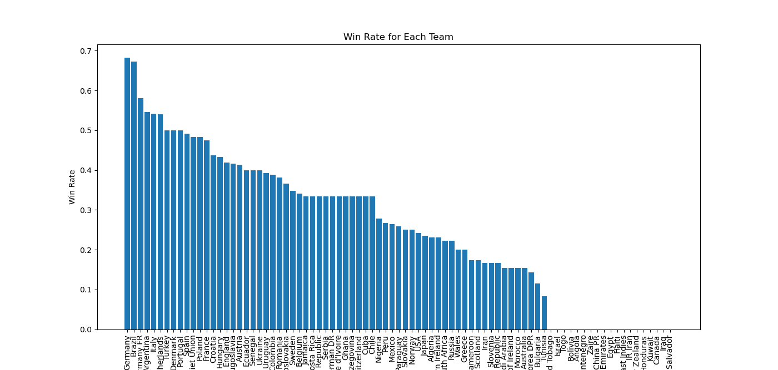
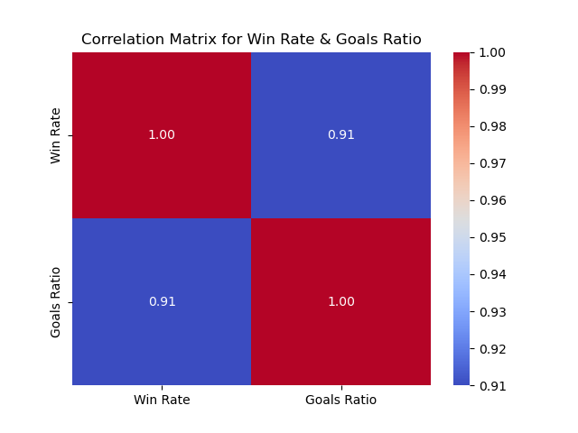
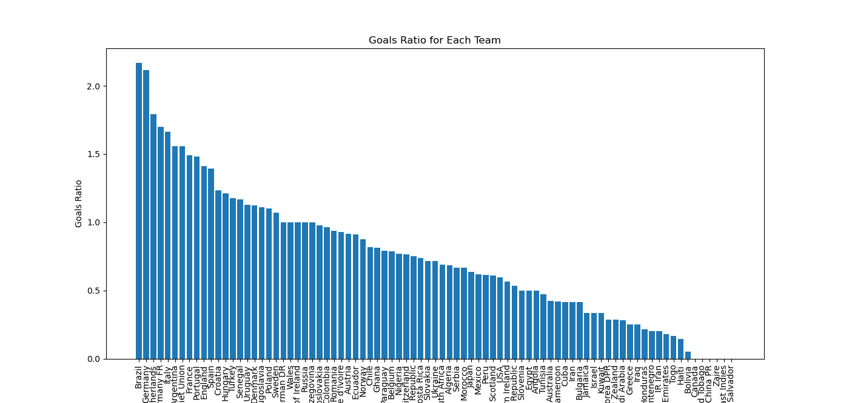
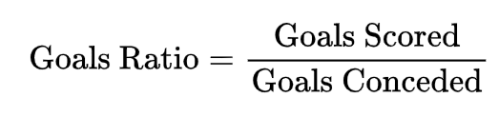
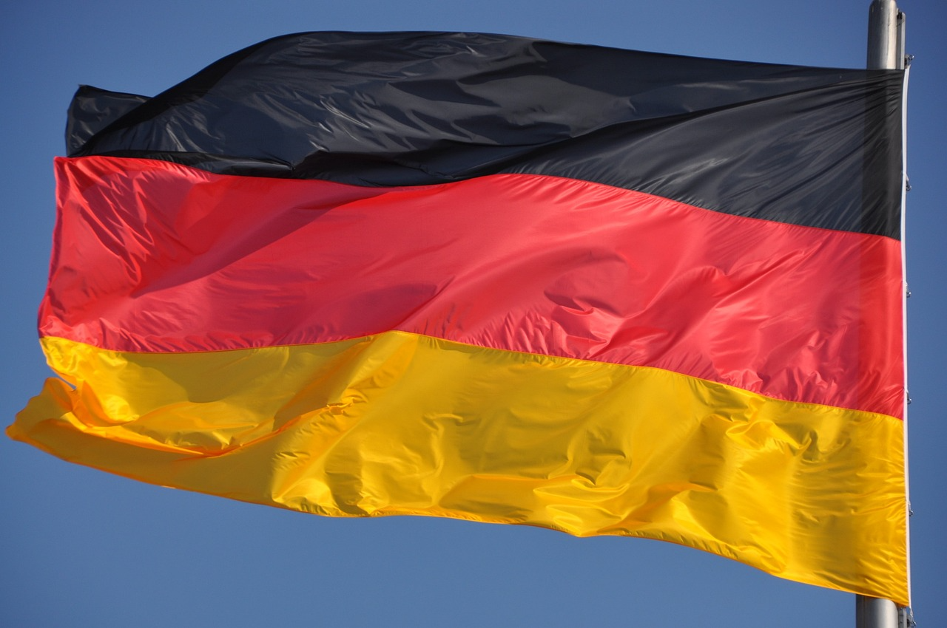
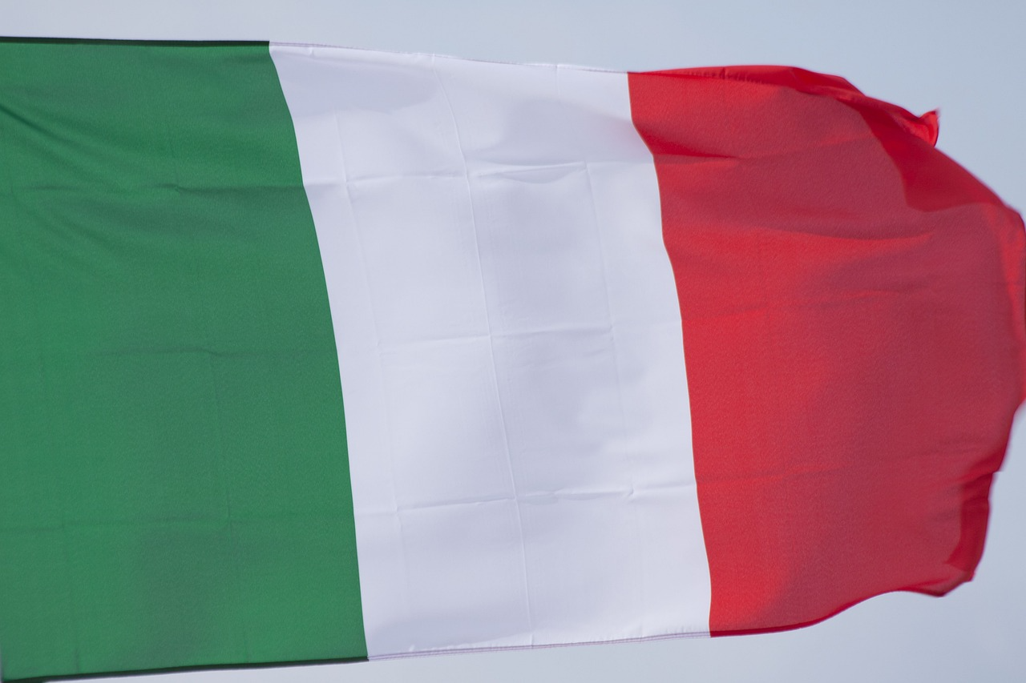
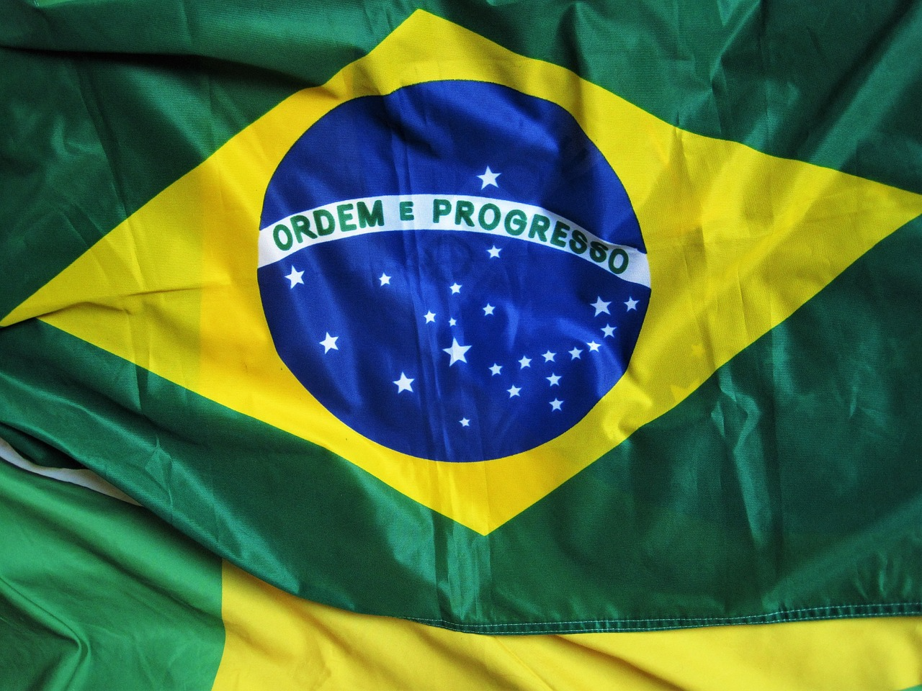
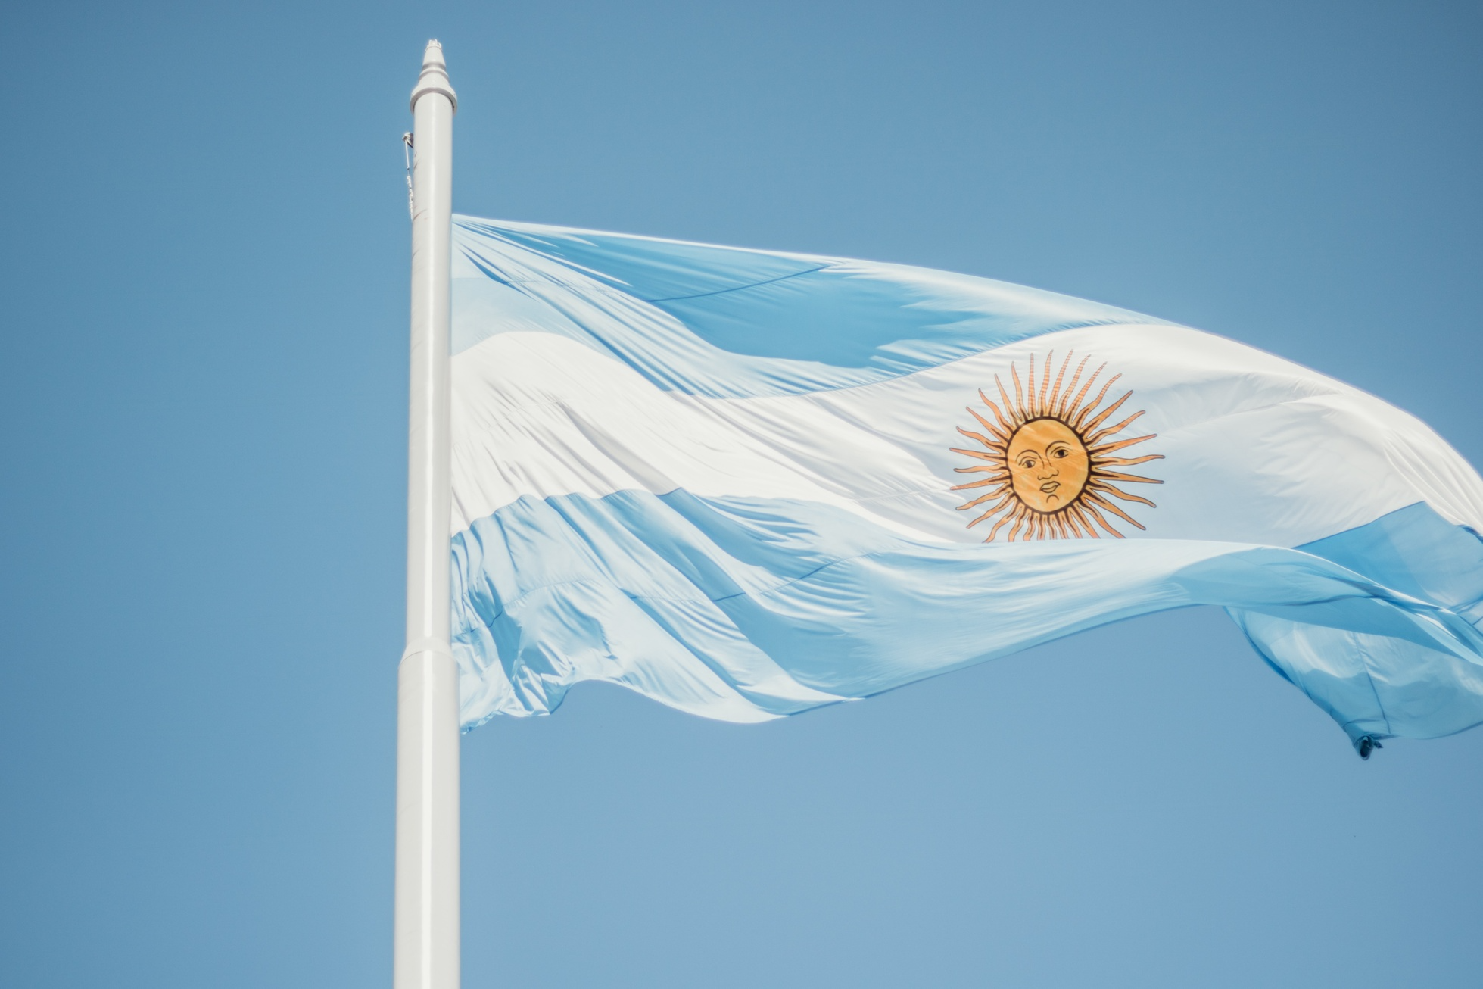
High correlation between the ratio of goals scored to goals conceded (goals ratio) and win rate
Notes:
Looking closer at goals and win rates, we define the goals ratio as goals scored divided by goals conceded. This ratio effectively reflects a team's offensive and defensive performance.
A higher correlation of 0.91 between this ratio and win rates was found. The top four teams in both win rate and goals ratio graphs were the same these four contires: Germany, Brazil, Argentina, and Italy.

Slide 6
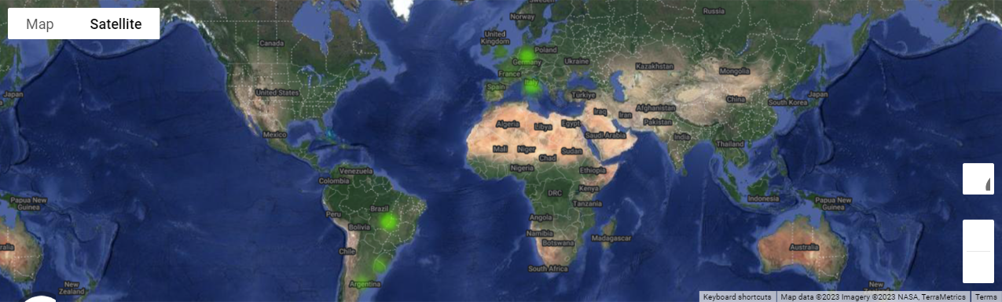
Goals ratio and win rate closely linked to the number of World Cup wins
Top-ranking countries show intense heatmaps in World Cup winner maps
Notes:
These four countries also stand out in the World Cup winners' heatmap, indicating closer link between goals ratio and win rate.

Slide 7
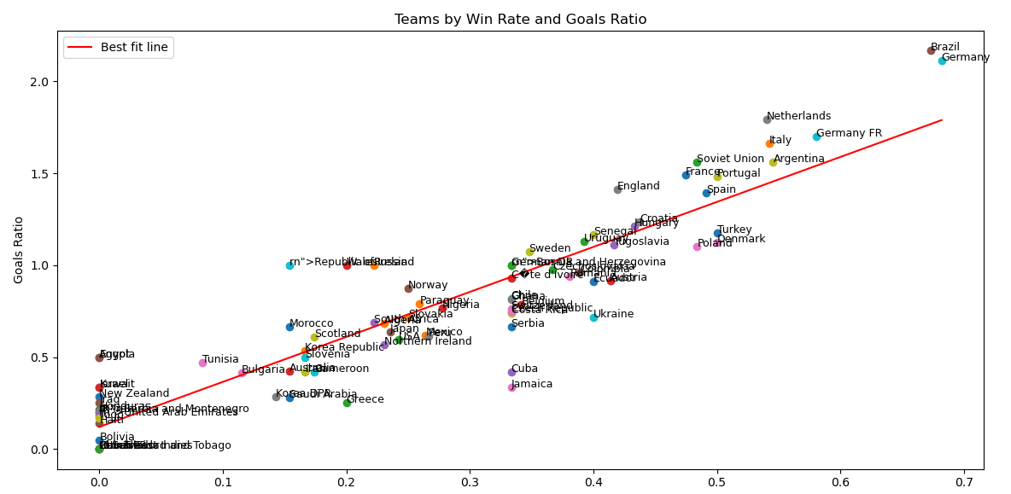
linear relationship between win rate and goals ratio
Notes:
Linear regression analysis revealed a clear relationship between a team's goals ratio and their win rate.
Teams with better goal ratios usually have better win rates.

Slide 8
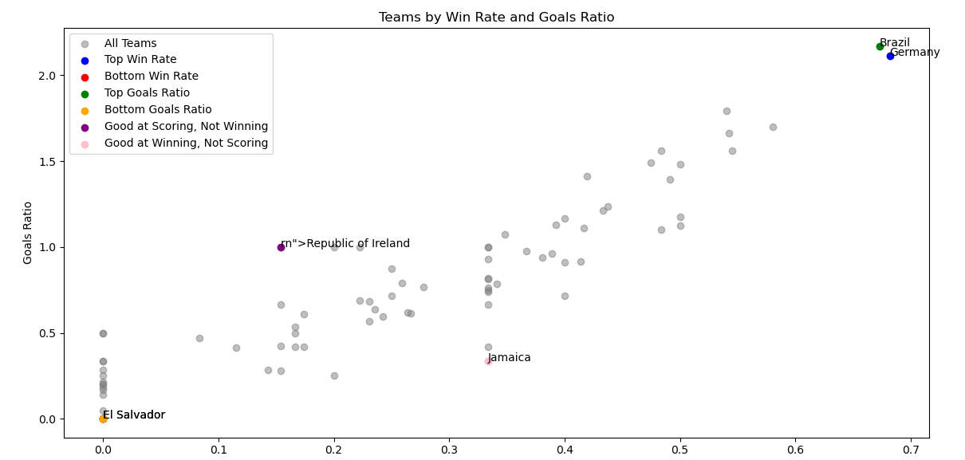
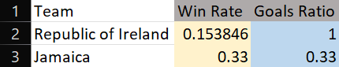
Exceptional cases
Notes:
However, there were exceptions. For instance, Ireland had a high goals ratio but only a 15% win rate.
On the other hand, Jamaica won 33% of their matches despite a lower goals ratio. Looking at these extreme cases, Ireland scored three times more goals than Jamaica, but their win rate was less than half of Jamaica's.

Slide 9
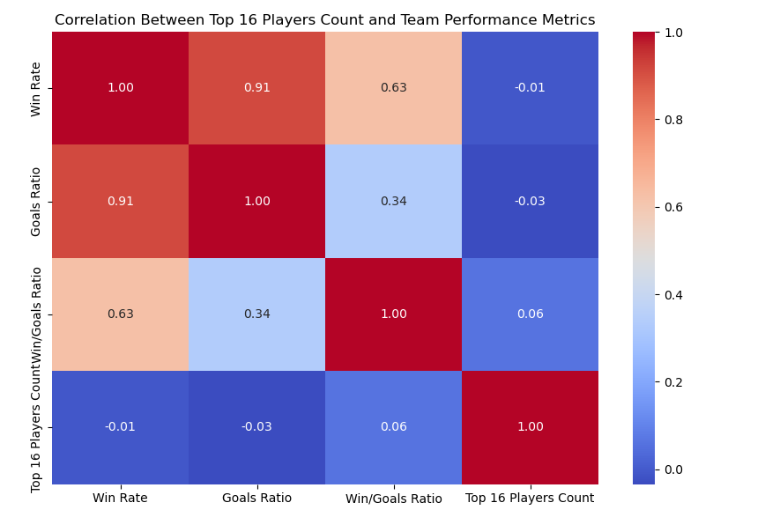
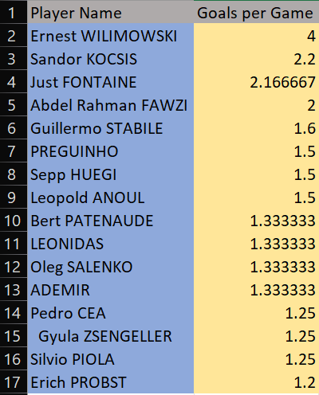
correlation between top scorers and team performance ?
Notes:
Even with a strong link between scoring and winning, teams with top scorers didn't always win more. This shows that in soccer, no one player is more important than the team itself.

Slide 10
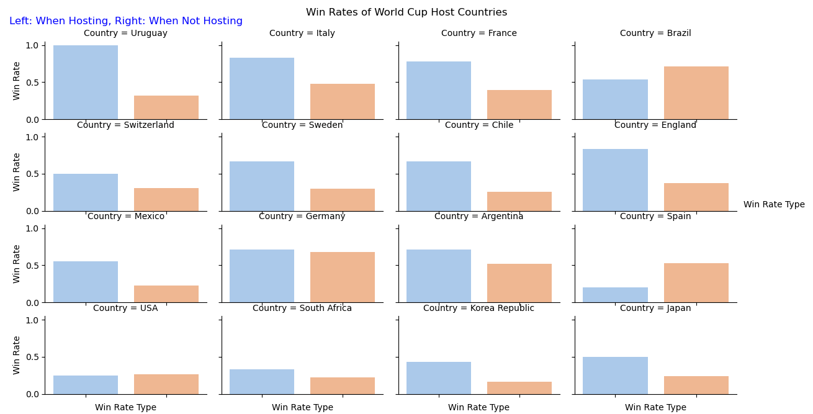
Impact of Hosting on Win Rates
Notes:
Regarding hosting impact, most teams, except Brazil and Spain, do better when they host the World Cup, suggesting a home advantage

Slide 11
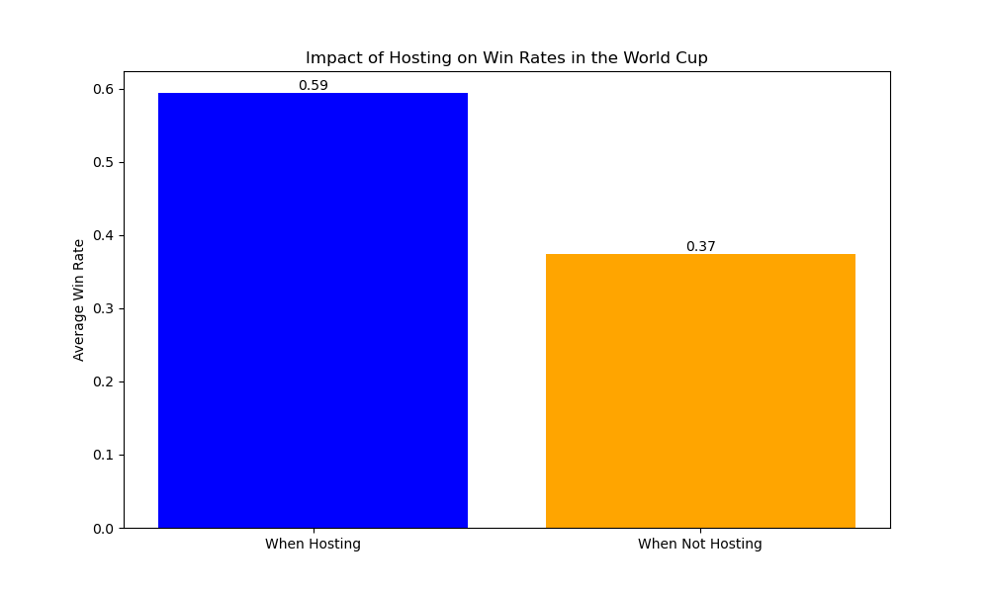
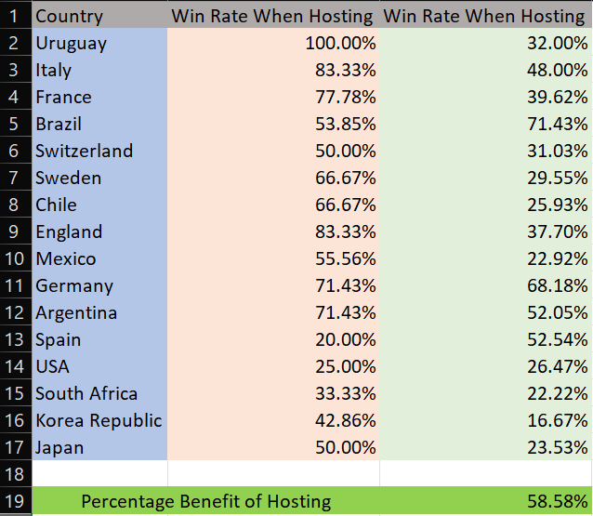
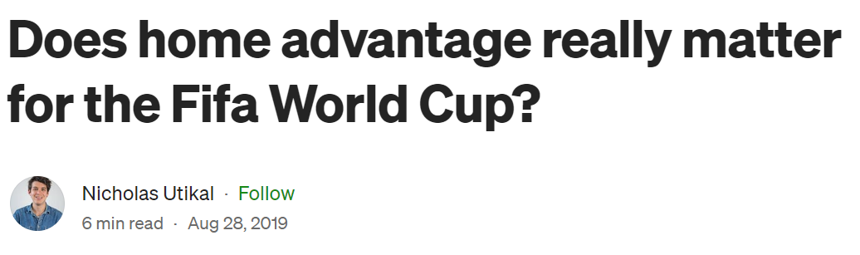
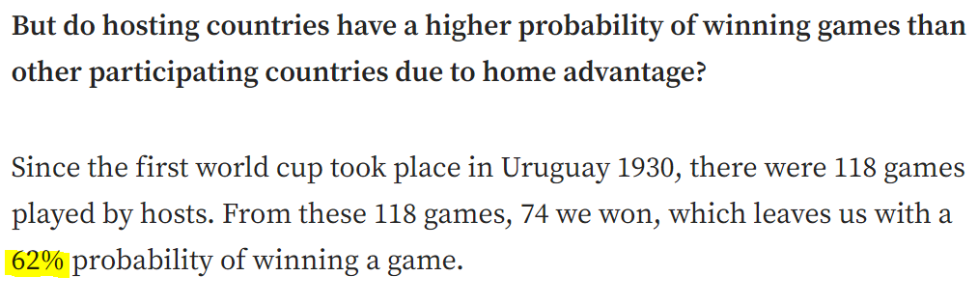
Higher win rates for host nations
Notes:
On average, hosting countries had a 59% win rate, 58% higher than when not hosting. This is significantly higher than expected, but recent articles confirm this high win rate for hosts.

Slide 12
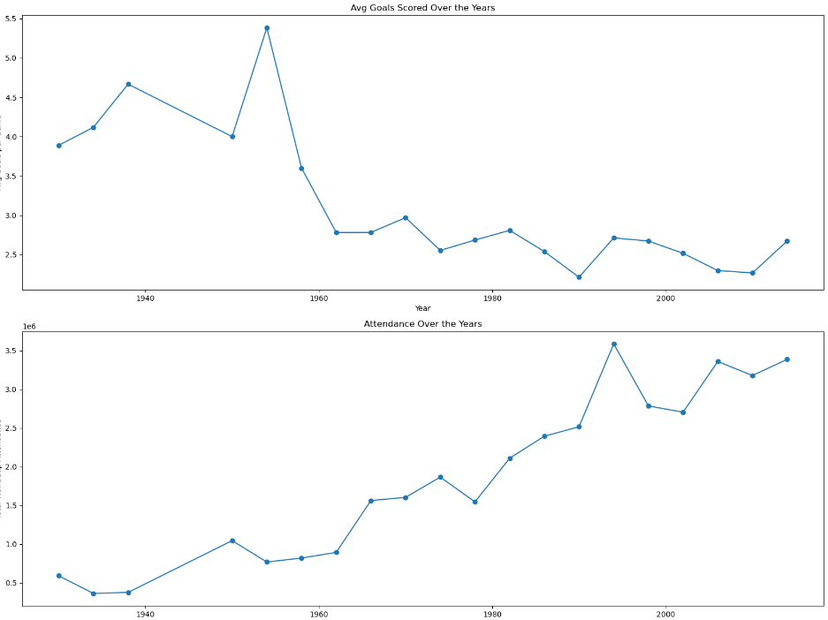
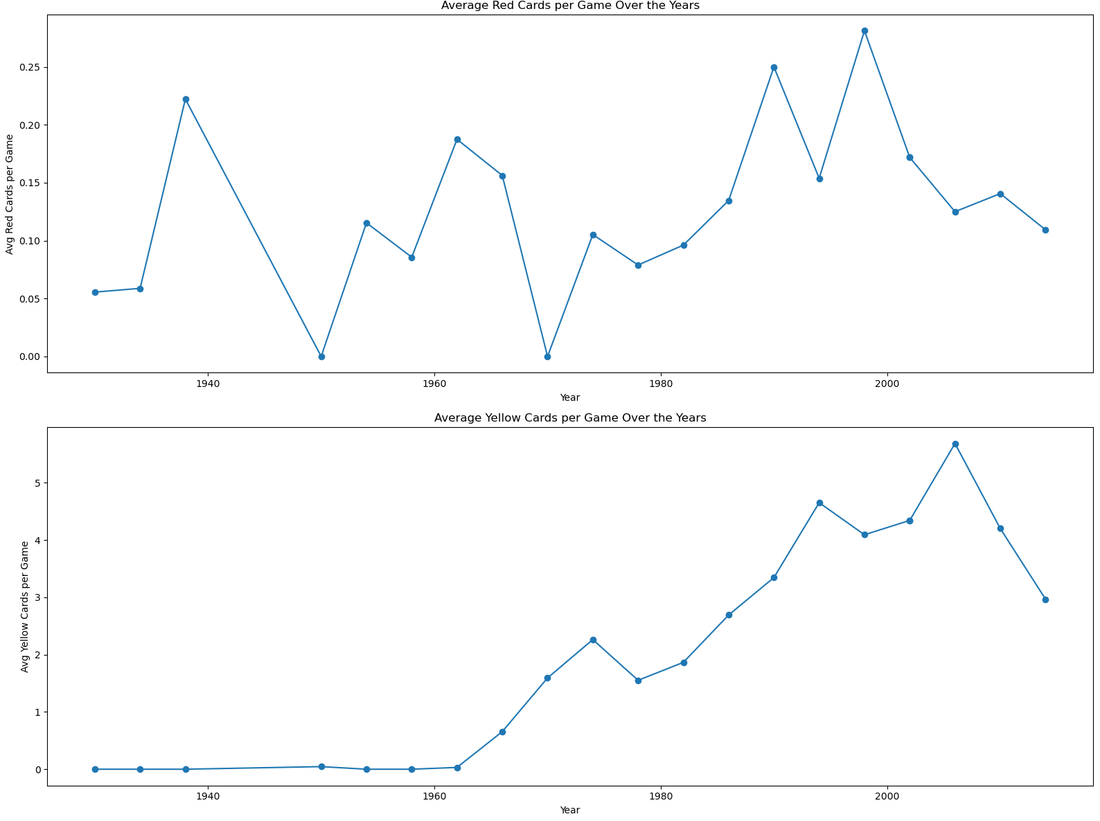


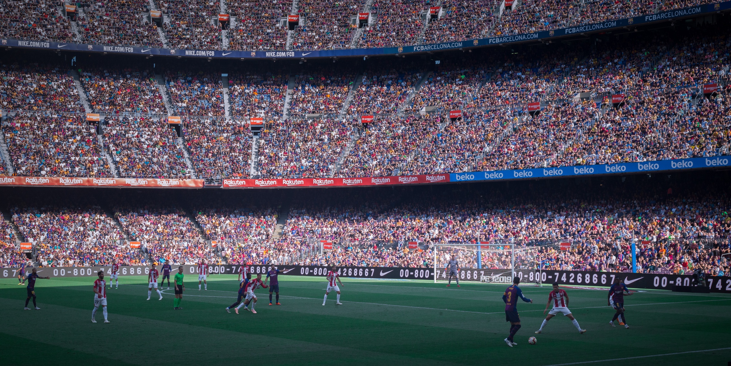
Evolving World Cup Trends
Rising trends in goals, attendance, and average yellow and red cards
Notes:
There has been a steady increase in audience size and card counts in World Cup matches over the years. However, when considering the number of matches played, the average goals per game have actually decreased.

Slide 13
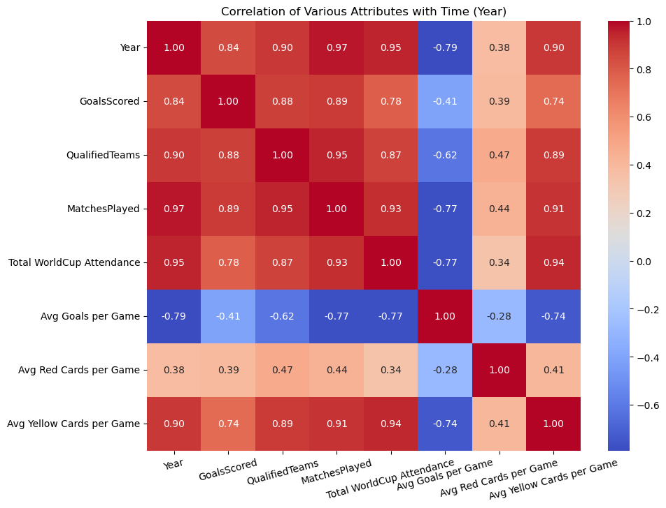
Notes:
The correlation matrix shows this trend as well. Looking at the correlation matrix, especially the first row, we see that almost all metrics have increased over time except the average goals per game.

Slide 14
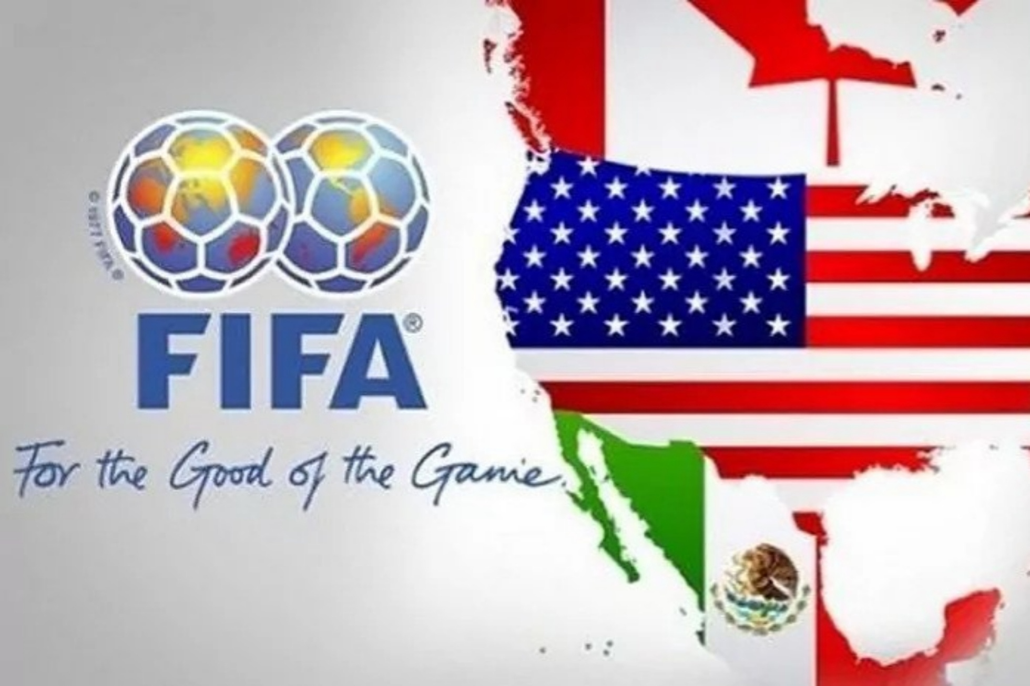
Predictive Insights for the Next World Cup
high goal differentials
favoring the host countries
Notes:
To conclude, focusing on the host country and each team's goal differential seems crucial for accurately predicting World Cup outcomes.

